Slide 1
Budget
9

Slide 2
Common Bank Fees
Monthly Maintenance/Service Fee: A fee charged for maintaining your account, often waived if you meet certain requirements like maintaining a minimum balance or setting up direct deposits.
Overdraft Fee: A fee charged when you spend more money than you have in your account.
Out-of-Network ATM Fee: A fee charged when you use an ATM that isn't part of your bank's network.
Insufficient Funds (NSF) Fee: A fee charged when you don't have enough money in your account to cover a payment.
Wire Transfer Fee: A fee charged for sending money electronically to another bank.
Foreign Transaction Fee: A fee charged when you use your debit or credit card for transactions outside of your home country.
Check Fees: Fees associated with using checks, such as check printing fees or fees for returned checks.
Inactivity Fee: A fee charged for not using your account for a certain period of time.
Early Account Closing Fee:

Slide 3
Overdraft Fees: overdraft fee is a charge from your bank when you spend or withdraw more money than you have available in your account, and the bank allows the transaction to go through anyway
Complete the Overdraft Fees Assignment

Slide 4
How to Prevent /Avoid Overdraft Fees?
Way to Avoid | Details:
Opt out of overdraft coverage | Bank provider cannot cover one-time debit card or ATM transactions – your card will be declined as no funds It can cover checks and recurring debit transactions (automatic bill pay)
Watch your account balances regularly | - Check your accounts weekly, daily, or before every transaction you make -Balances can be checked online, via mobile app, by a phone call or by visiting an ATM or branch.
Set up alerts for low balances | - get notified when an account goes below a certain threshold that you set. - Example: Set to get when account balance is below $75.00
Link to another account Overdraft Protection | Bank may offer an overdraft protection transfer service. Linking your checking to another account, such as a savings or credit account Linked to Saving automatic withdrawal from that account Linked to A Credit Account – you have to pay it back - Usually a fee, but less than the standard $35.00

Slide 5
Overdraft Protection
If you withdrawn money from your account for more than what is in your account = Overdraft or NSF:
  Ex: You use your Debit card for $5.00 and only $1.00 in account
  Bank charges $30 - $35 overdraft fee for every overdraft
  Entered as NSF in your account
  New law in 2010 prevented banks from charging fees when you sign up for Opt Out Overdraft Coverage
Overdraft Protection
  Your transactions are covered even if you have insufficient funds because linked to an account
  A fee is normally charged for this service - $20 for the year
  Check the bank for your options

Slide 6
Money For Spending and Savings
Income: is money that an individual receives for work conducted or through investing capital
Income can come from
  Wages or Salaries
  Interest
  Dividends - money paid regularly (typically quarterly) by a company to its shareholders out of its profits
  Capital gains - a profit from the sale of property or an investment
  Pension/Social Security payments received during a given tax year

Slide 7
Money For Spending and Savings
Net Income: Total wage after taxes are withheld. This money is used to pay for necessities, to save, or to spend on wants
Disposable income is the amount of money you have left over after you've paid all your federal, state and local taxes (net income) and is first used to pay for fixed and variable expenses – used on needs
  Examples: rent, utilities, cell phone, insurance, transportation
Discretionary income is the money you have left over after you've paid your taxes and necessary expenses (needs) – spend on what you want
  Eating out, subscriptions, movies, concerts etc.
Checking account, SHOULD BE USED TO CONTROL SPENDING & SAVINGS.

Slide 8
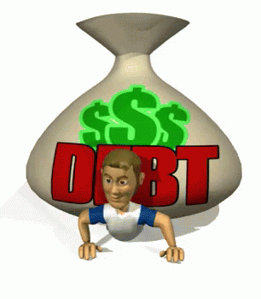
Assets
Assets: things you own that have present or future monetary value Common examples of personal assets include:
  Cash: checking, and savings accounts, CD values, money market accounts, physical cash
  Property - land, cars, boats, collectibles,
  household furnishings, jewelry, vehicles
  Investments – annuities, bonds, the cash
  value of life insurance policies, mutual
  funds, pensions, retirement plans (IRA,
  401(k), etc.) stocks
Debt: something, typically money,
that is owed or due
  Bills, loans (house, car, boat etc.)
  Credit Card Debt
  College Loans

Slide 9
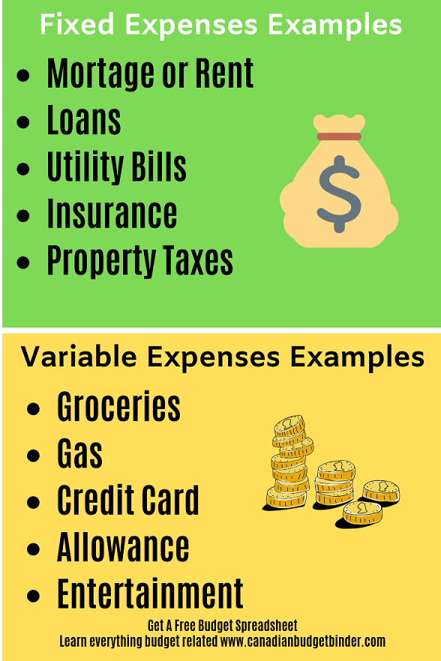
Fixed Expenses: payment amount stays the same each month:
  Disposable income
Variable Expenses: the amount you spend may vary each month
  Can be disposable or discretionary

Slide 10

Assets?
True or False, the more you own,
the more wealthy you are?
Many people think that being wealthy means
you own “a lot of stuff”.

Slide 11

Answer the following in your notes:
Your friends and you notice a person who always has brand new clothes, fancy cars, shoes, and electronics. What would you need to know in order to tell if this person is wealthy?

Slide 12
Assignment
Google Classroom Assignment and complete the Ed puzzle 50/30/20 Budget
Answer the following in your note Packet:
Budget definition:
50/30/20 Plan for Budgeting
Examples of Needs
Examples of Wants

